Slide 1
Build internal capability, not consultant dependency
DevOps Enterprise Summit London - May 2021
Courtney Kissler, CTO, Zulily - @chawklady
Suzette Johnson, Enterprise Lean/Agile Lead, Northrop Grumman - @drsuz_johnson
Notes:
Courtney do the title intro, then we each do a quick intro - https://telepromptermirror.com/telepromptersoftware.htm

Slide 2
The belief...

Slide 3
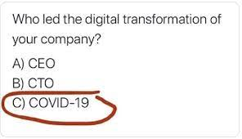
Reference: https://www.forbes.com/sites/blakemorgan/2020/04/05/is-covid-19-forcing-your-digital-transformation-12-steps-to-move-faster/?sh=44baa18c617b
Notes:
Suzette start, ask Courtney: Who is driving your DevOps transformation?
Courtney: Talks about new ways of working
Courtney: Suzette, can you talk about what is needed to avoid creating consultant dependency?

Slide 4
The needs...

Slide 5
Accountability
Retain accountability for all decisions.
Hire the consultant(s) to work with you not do things for you. (Have clear intent)
Have a process for evaluating the effectiveness of your consulting engagements.
Notes:
Suzette speaks to this and transitions to Courtney

Slide 6
Clearly understand dependencies
Define how critical the new capability is in meeting your business outcomes.
Before starting have a defined working agreement that articulates how your team and the consultants will work together towards a common goal.
Clearly define the work of the consultants and the work of your team with regular demonstrations of progress against the goals.
If the system the consultant is building breaks, ensure your people have the knowledge and skills to fix and maintain it. Your employees must be engaged throughout the effort.
Don’t use proprietary methodologies – you will need to hire people before the consultants leave who understand outcomes, not methodologies.
Build the knowledge and skills of your people so they are empowered.
Notes:
Courtney: Suzette, can you talk about the importance of building synergies amid complexity?

Slide 7
Build synergies amid complexity
Create a clear win-win for your company and the consulting company.
Ensure the consulting company truly understands your business and the problem you are trying to solve. Regular communication is essential.
Be committed. Ensure you have the internal people ready to partner with the consultant(s).
Buy-in. Internally, are you bought into what the consulting company is doing?
Notes:
Suzette speaks to and then says Courtney, execs are usually wondering what is the “ask”?

Slide 8
The ask...

Slide 9
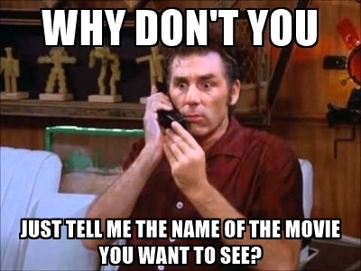
Reference: https://www.kustomer.com/blog/3-seinfeld-situations-made-us-want-shout-serenity-now/
Notes:
Courtney

Slide 10
Build internal capability, not consultant dependency

Slide 11
In Summary
Define the win-win.
Co-create and build synergies.
Be clear with accountabilities.
Treat people as equals.
Be open minded.
Listen to understand.
Create a structure to verify health of the engagement.
Use common language/vocabulary.
Notes:
Split - Suzette take first 4, Courtney take final 4
Win-win is not a “powerpoint presentation”
Win-win is creating a capability that can be developed and owned internally
Don’t be insular - you brought in external help for a reason, leverage it with clear intent

Slide 12
Stay tuned for the upcoming release of this guidance as part of the 2021 DevOps Enterprise Forum!
Previous year’s guidance can be found at https://itrevolution.com/free-resources-sign-up/
Reference: https://www.pinterest.com/pin/160370436710406319/

